Slide 1


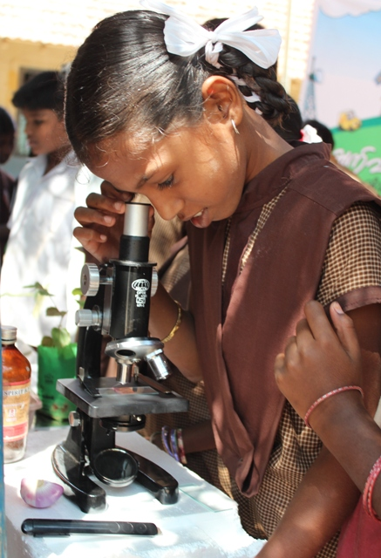
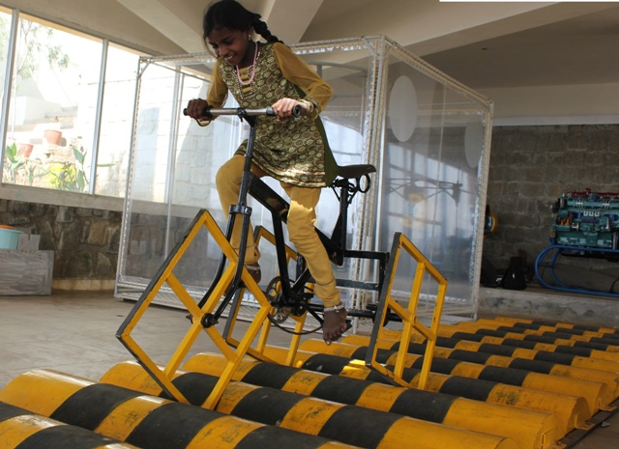
“Improving the school infrastructure & systems to support girl’s education”
Anil Joshi, 21-06-2015
shiksha . samskara . sansara

Slide 2



AGASTYA MISSION
MISSION
Spark curiosity, creativity, and leadership through:
Experiential, hands-on science education
Peer-to-peer learning
Teacher education
Scalable learning methods
Sustainable and environment friendly
Make learning
Fun!
Useful!
Accessible!
AAH!
AHA!
HA!HA!

Slide 3
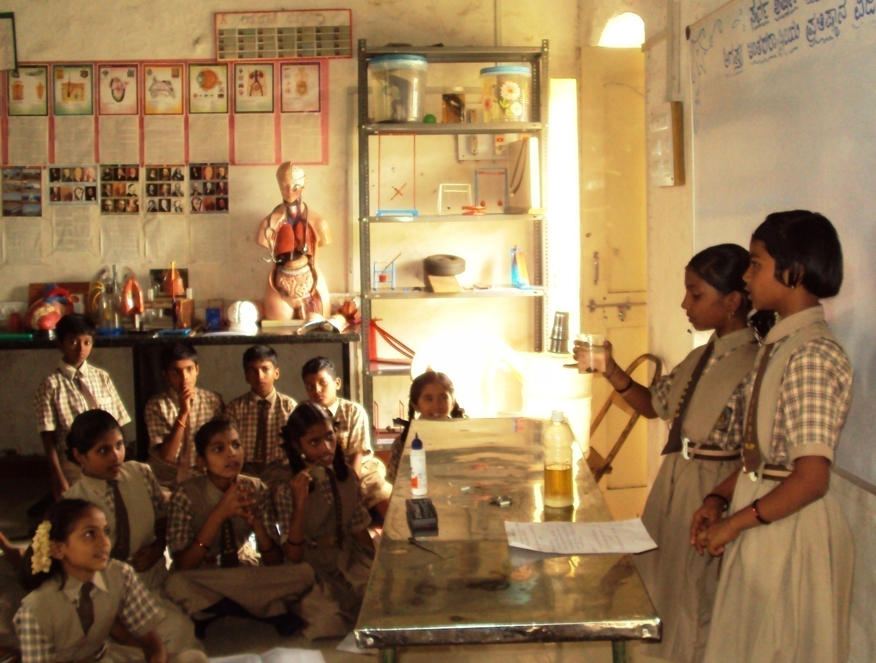
Thought Behind Starting AGASTYA!!!

Slide 4
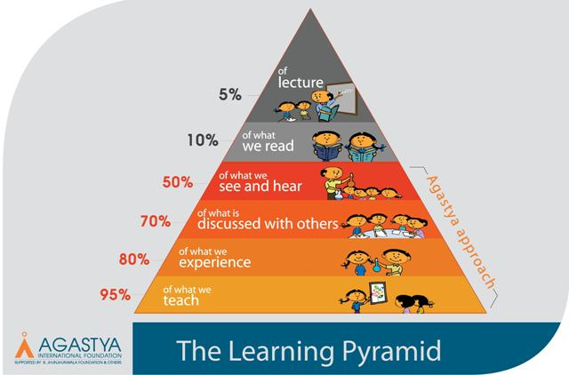
Learning Pyramid
MISSION

Slide 5
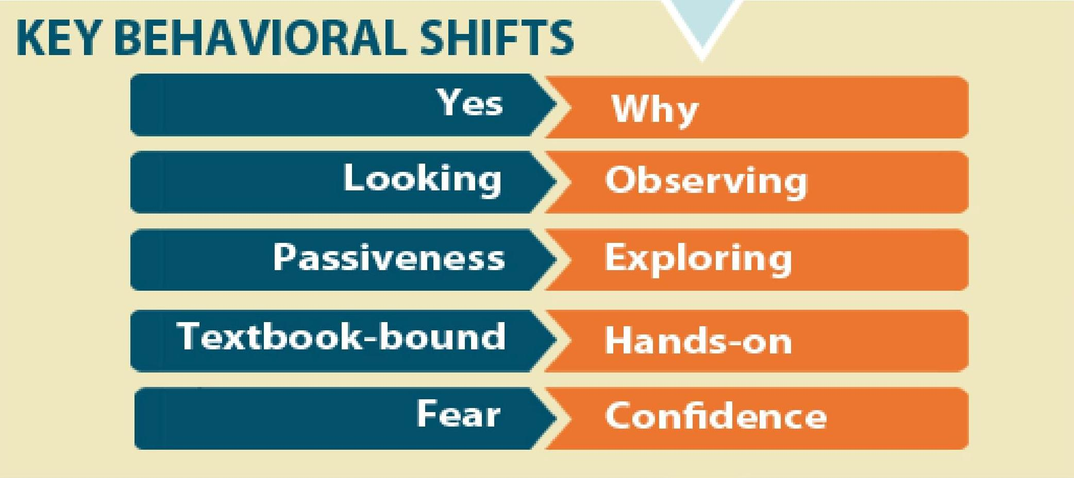
Transforming Attitudes
MISSION

Slide 6
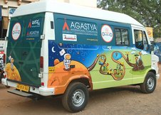
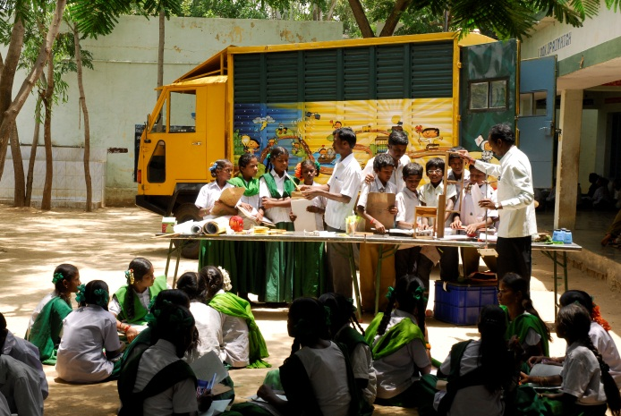
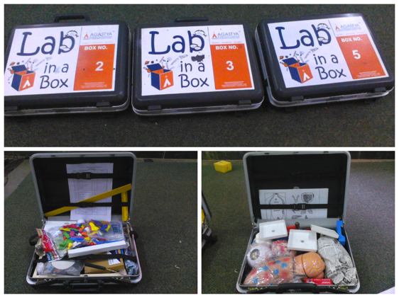
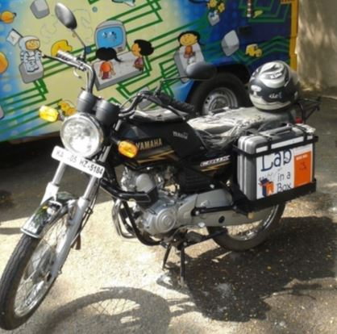
Delivery channels
shiksha . samskara . sansara

Slide 7



AGASTYA’s OUTREACH
50 Lakh Children, 2 Lakh teachers
47
Science
Centers
Programs
Hands-on Science
Blended Learning
Teacher Training
Young Instructor
Leaders
Low-cost model making
Tod Fod Jod
Make Your Own Lab
Gifted Children
Library & Community Reading
Operation Vasantha
Performing Arts
133
Mobile
Labs
59
Lab On Bikes
105
LIB Sets
16 States
88 Districts
To be launched
172 Acre Campus
290
Night
Village Schools

Slide 8
Observed Gap/s ...!!
Opportunity on the Hands –ON
Interactive models & TLMs
Skills to handle the material to generate their own TLM
Methods to use the appropriate model / TLM
Facilitation for an individual / group to perform the Expt... Explore... & Experience... !!!
Awareness & optimum use of the available resources
Learner network & mentorship : Peer - Peer

Slide 9
What Agastya is doing ... !!!
Cost effective, Hands-ON ,Experiential ,Interactive LAB service @ door step
Allow the kid
  to touch & feel the model/ TLM
  to observe it closely , question it , explore and connect to daily life situation
  to share the learning to their peer
  to experience the joy of learning.
Structured class room specification
Demonstration , share & train : child- centric pedagogic practises (Demo-ABL- PBL etc )
Sharing & learning network with teachers to enable the Agastya resources
Low cost model making : Generating the TLMs independently
Innovations on the delivery channels, to reach out rural school

Slide 10
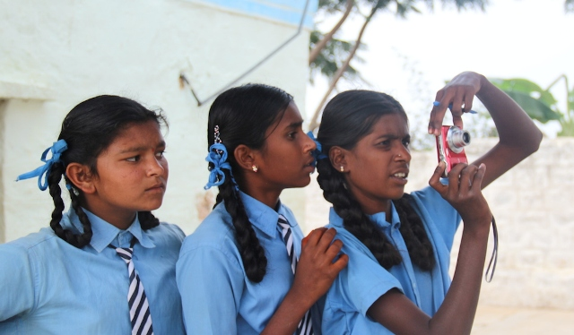
Impact on the Girls !!!
Observations from various Agastya Facilities
Girls are more interactive, proactive & confident than boys
Good in initiation , taking lead & are more participative
They ask more curious questions
Continuity in studies & Aspiring for higher education
Reduction in the drop out rate
Speaking with parents & teachers confidently
Marriages are getting delayed
shiksha . samskara . sansara

Slide 11
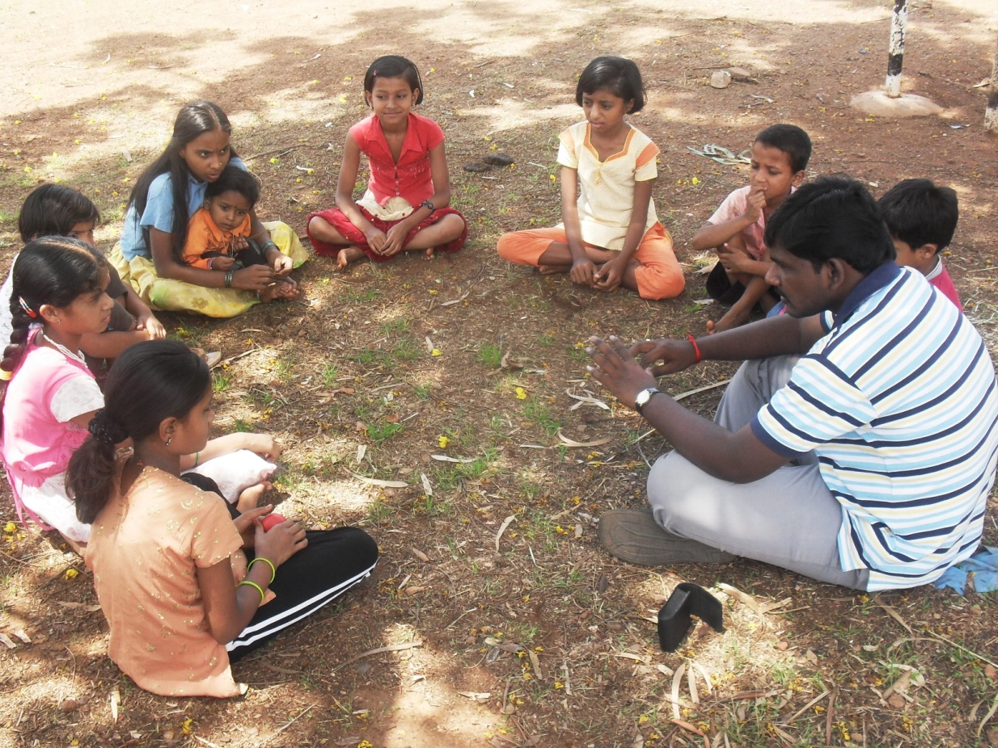
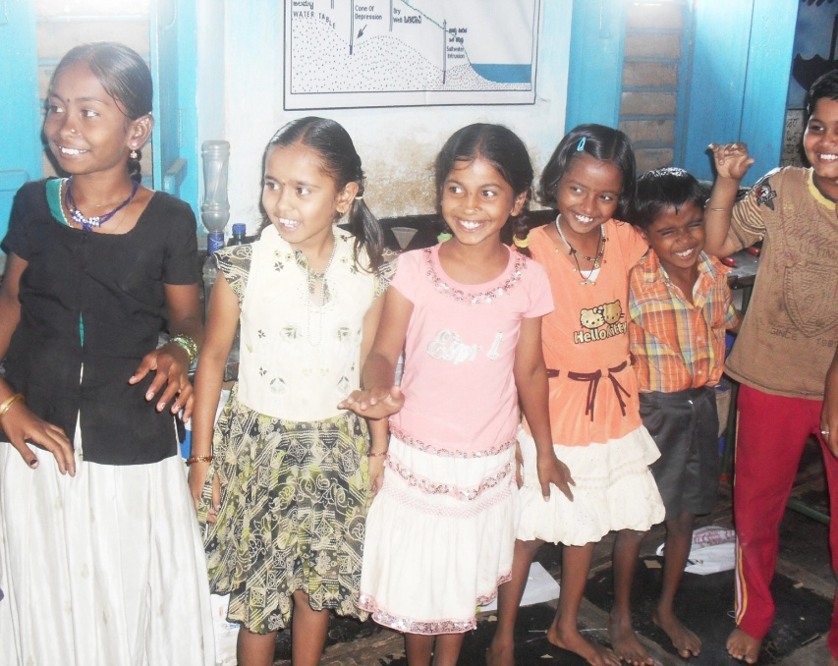
Evidences !!!

Slide 12
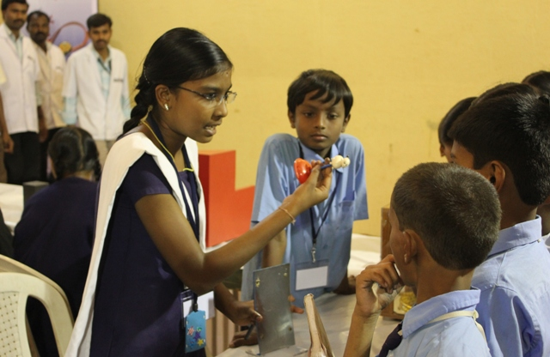
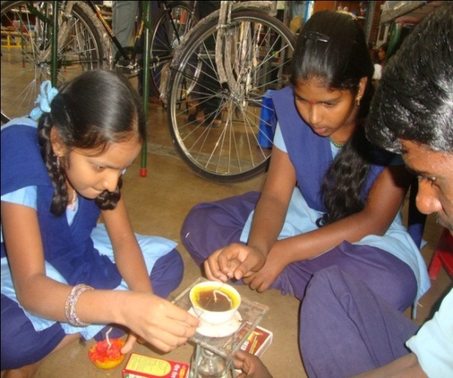
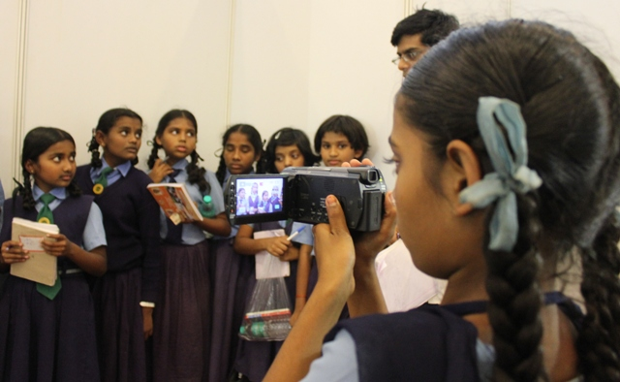
YOUNG - INSTRUCTOR - LEADER (YIL)
In 17 locations of 7 states
Out of 6091 more than 50% are girl YILs
Since 2009 till 2015 .. Girl student participation increased from 42% to 55%
shiksha . samskara . sansara

Slide 13


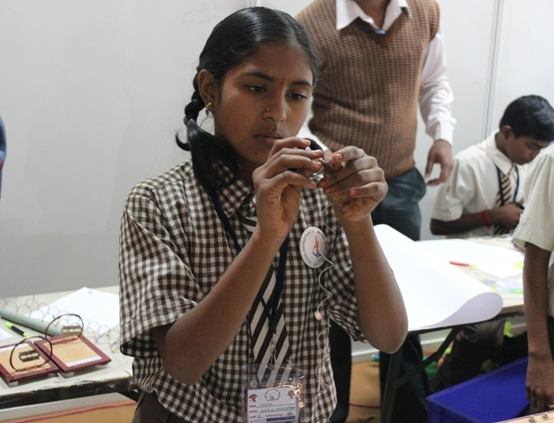
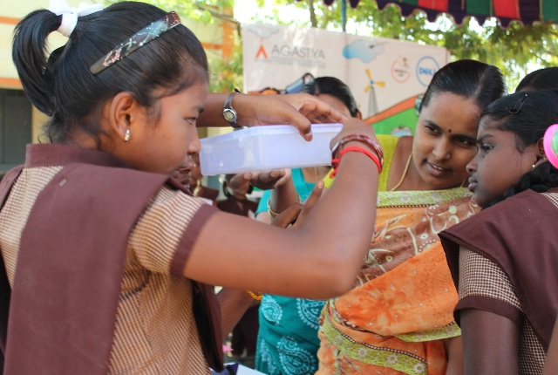

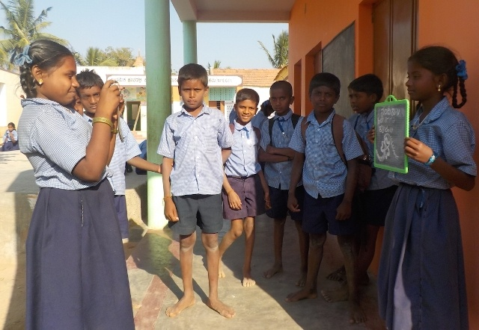
shiksha . samskara . sansara

Slide 14
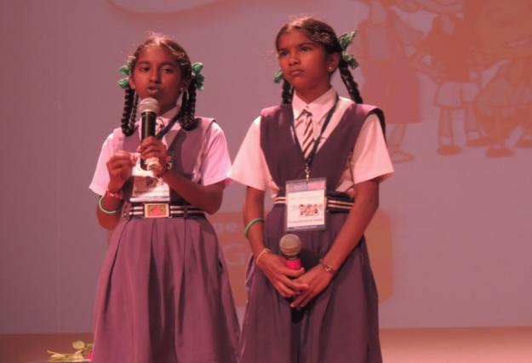
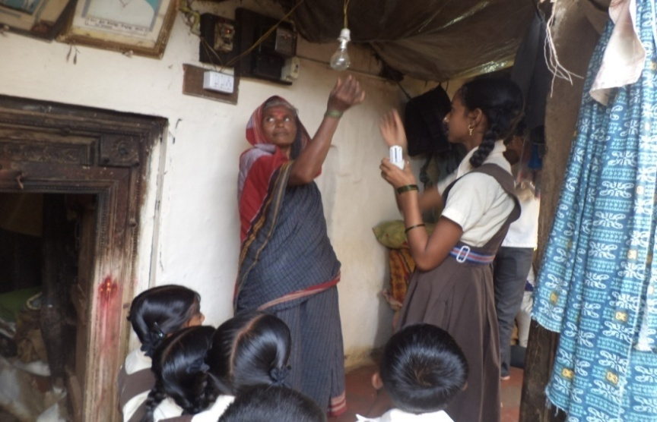
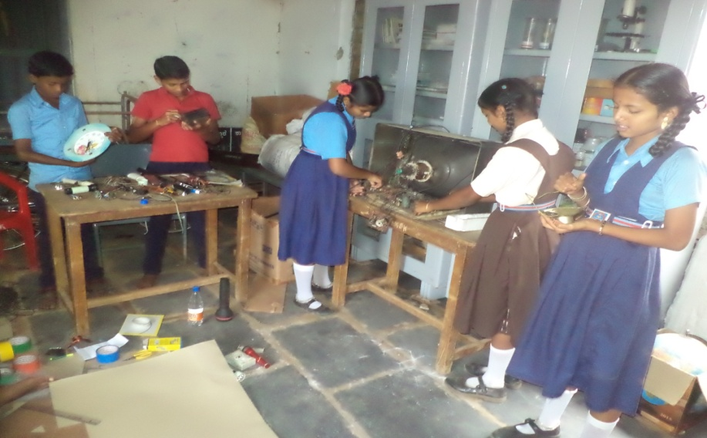
Design For Change (DFC)
Since 2011, 205 projects exhibited in DFC with active participation of 615 girl students
- Out of 205 projects 29 projects bagged award at national level competition

Slide 15
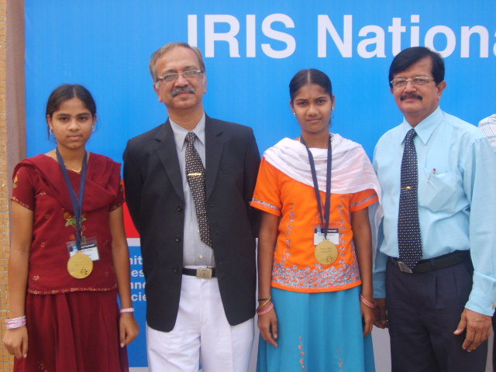
INTEL Initiative for Research and Innovation in Science (IRIS)
National Innovation Foundation (NIF)
Design For Change (DFC)
Space Kids India
Karnataka Bala Vikas Academy (KBVA)
Science Society of India (INSEF)
PBL Students are Participating in Various State/National/ International Competitions
Project Based Learning (PBL)
From 2008 – 2014, Agastya mentored more than 95 research projects, were submitted to Intel IRIS & other national level innovation fairs.
Out of which 25 are awarded
More than 85 girl students from Govt schools proactively participated

Slide 16
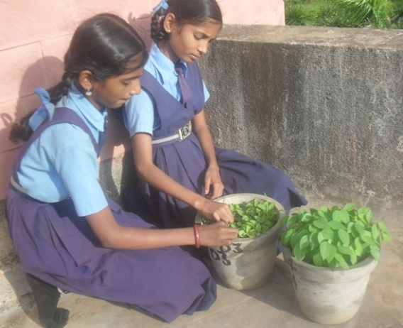
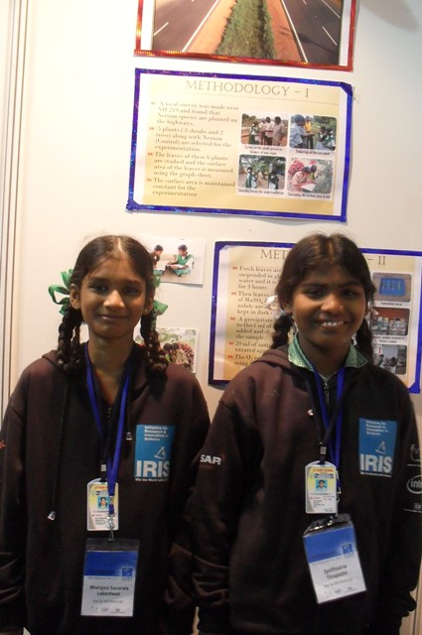

Slide 17
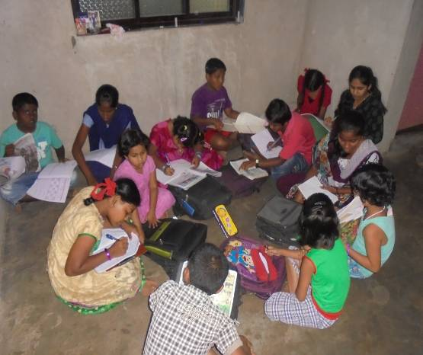
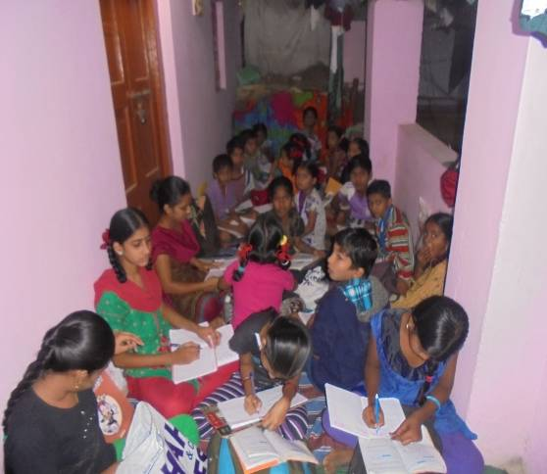
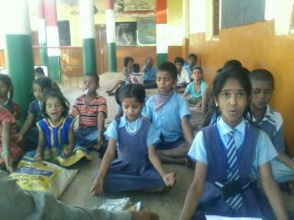
OPERATION VASANTHA
Initiated by girl ‘VASANTA’
Volunteer driven
290 OV centers working in 6 states of India
8700 children getting benefit, out of it 70% (6000+) are girl students
290 volunteers actively engaged out of it 90% (260) are female volunteers
shiksha . samskara . sansara

Slide 18
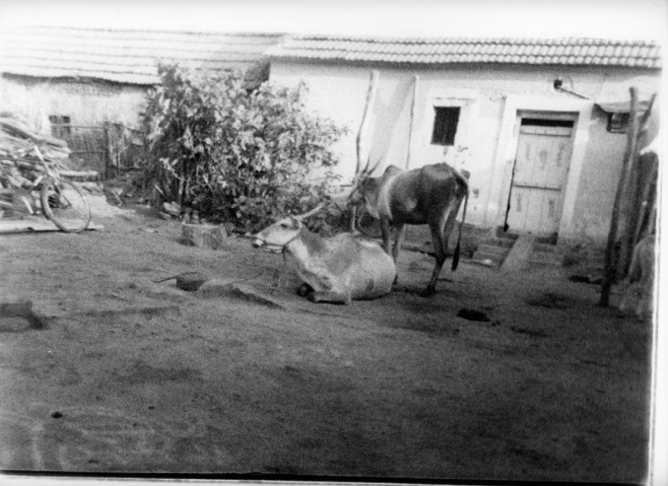
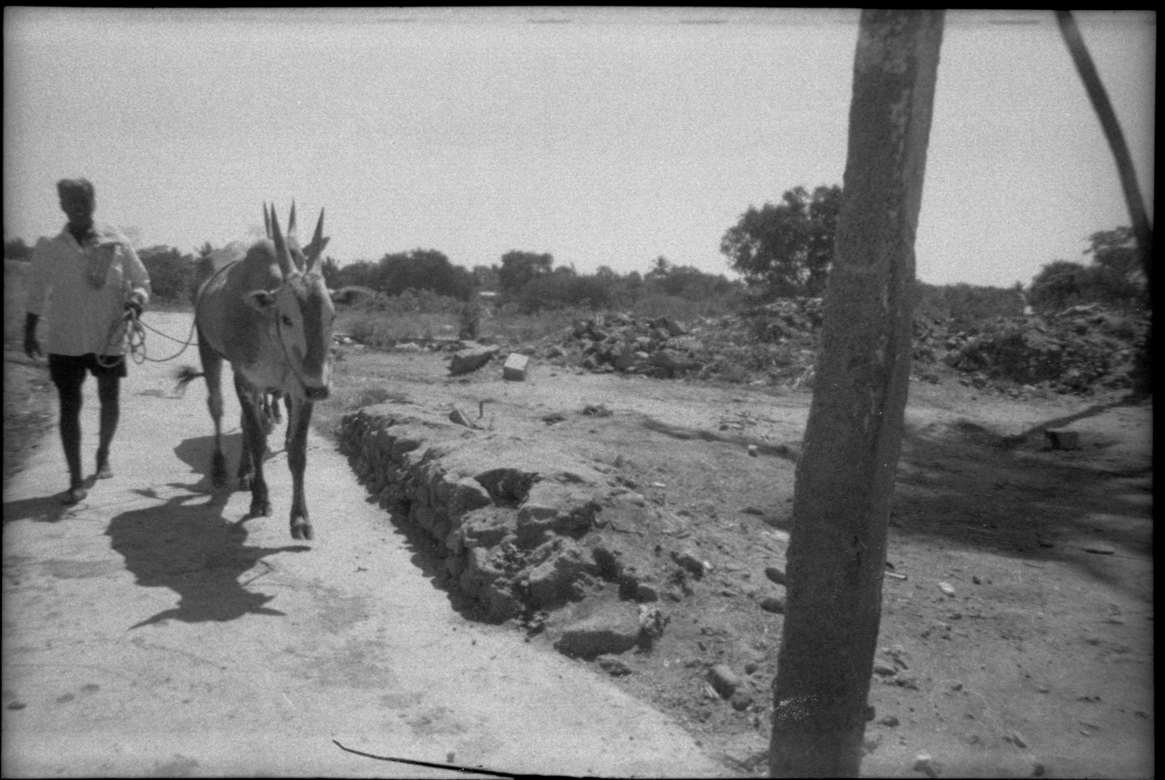
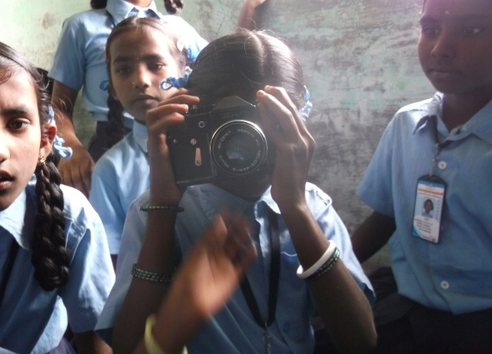
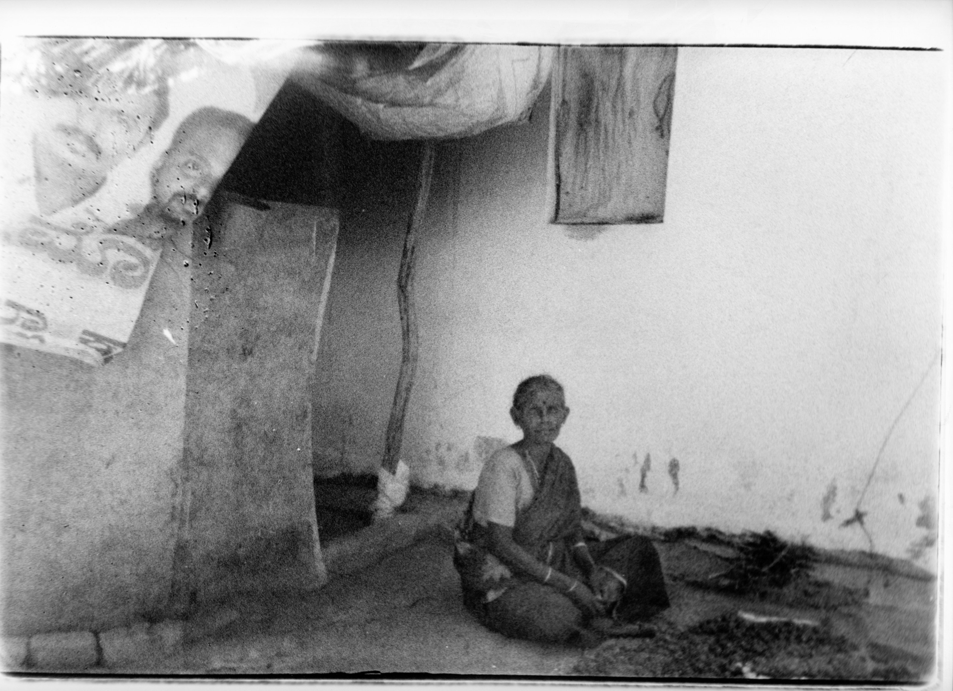
Photography
1007 Girl students participated & trained on photography, video shooting & science behind it
Also they did pin hole camera & paper camera
Kids were allowed to explore the working of digital camera
Also they did the processing of photo prints of the roll camera
shiksha . samskara . sansara

Slide 19
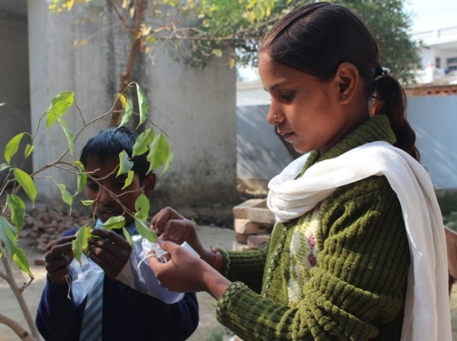
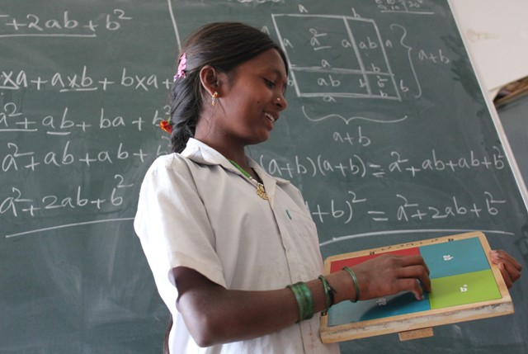
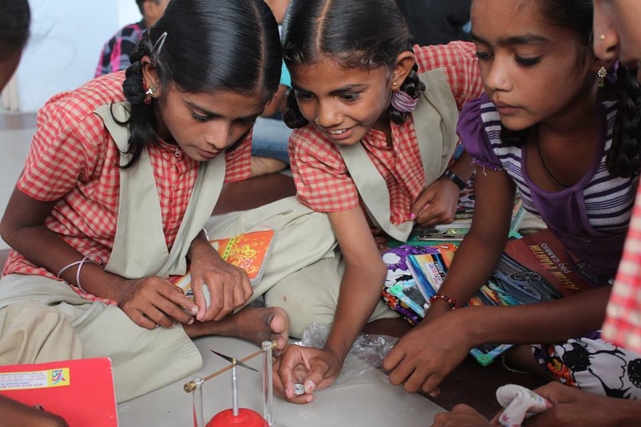
Exclusive for girl students
Through GEs
  Running 6 Lab On Bike facilities exclusively for Girls
  Installed 5 permanent Science Centers at 5 Girls schools
  Distributed scholarship for 100 Girls for Higher education
Since 2010-2015 , Agastya is supporting annual scholarship to more than 480 girls students to pursue their higher education
shiksha . samskara . sansara

Slide 20
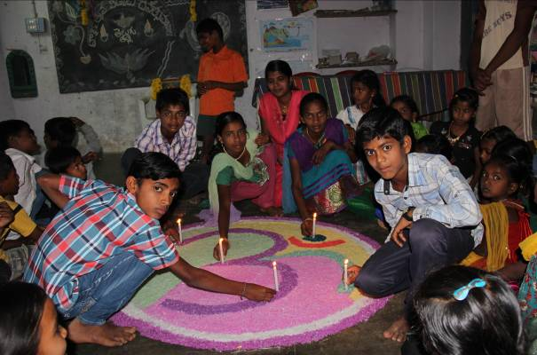
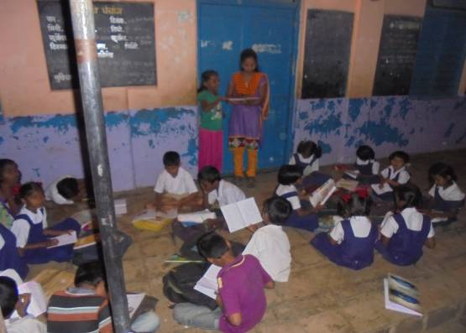
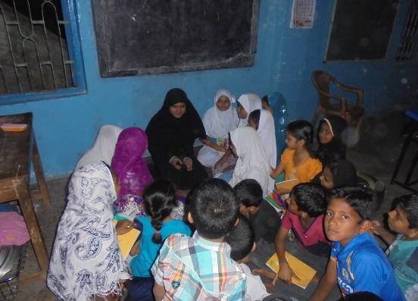
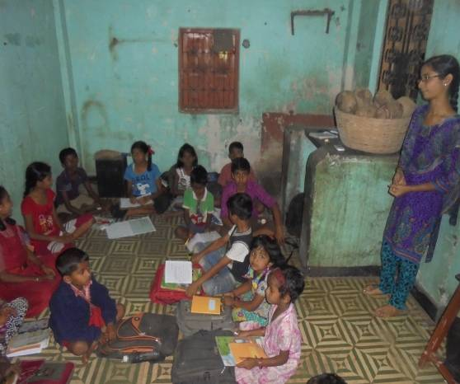
OV Centers
shiksha . samskara . sansara

Slide 21

Come !!! …Lets work together…
Thank You

